Slide 1

CLEARX cosmetics

Slide 2

About us
CLEARX Cosmetics was established in; 2021 and it is a cosmetics company in Nigeria known for its commitment to quality, innovation, and community engagement. With a diverse product range, locally-sourced ingredients, and a customer-centric approach, the company has solidified position as a trusted name in the Nigerian beauty industry and is poised for further growth and expansion..

Slide 3
Business Problem
Data fragmentation : Sales data is collected manually across the three branches, leading to fragmented, error-prone records
Limited data analysis: The lack of data analysis tools hinders the company's ability to gain insights into customer preferences, and regional trends
Resources allocation: CLEARX Cosmetics struggles to allocate resources efficiently, leading to stockouts or overstock situations.

Slide 4
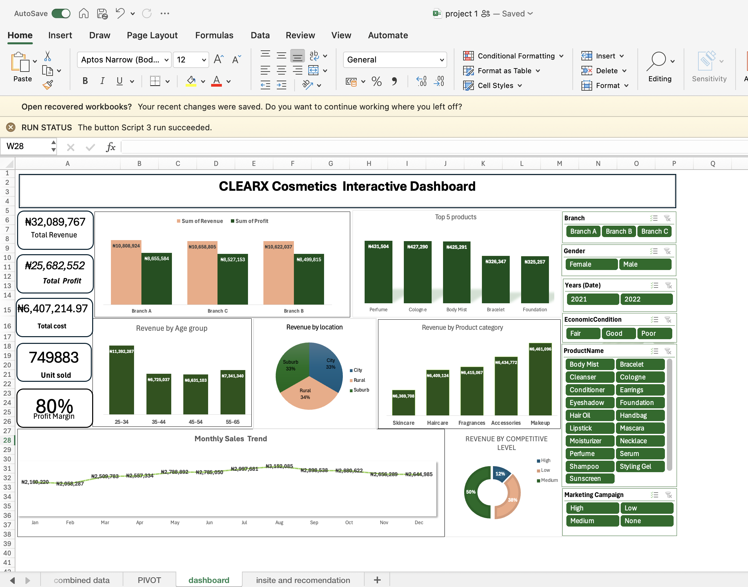
This dashboard enables data-driven decision-making by visualizing; revenue by product category, competitive level, age group revenue distribution, location, monthly sales trend along side with slicers to effectively interact with dashboard.

Slide 5
Key performance indicator Summary
Total Revenue: ₦ 32,089,767
Total Profit: ₦ 25,682,552
Total cost : ₦ 6,407,214
Units Sold: 749,883
Profit Margin: 80%

Slide 6
Revenue and profit across the three branch
Branch A has the highest revenue (₦10.8M) but also highest costs,.
Branch C and Branch B have almost similar revenue (10.6M) and almost similar profit of (8.5M) but slightly varying profit margins. This indicates consistent demand across the three branches. The three branches are consistently contributing to business development

Slide 7
Revenue by Product Category
Makeup (₦6.46M) and Accessories (₦6.43M) are top revenue contributors.
Skincare (₦6.36M) and Haircare (₦6.40M) follow closely, suggesting strong demand across categories.
It is best for business to prioritise Makeup and Accessories by investing more on them as they generate the highest revenue. This will maximize profit and make business more profitable.
Skincare products having the lowest revenue among all categories. A targeted marketing strategy, such as promotions, influencer collaborations, and discounts should be implemented to boost sales.

Slide 8
Revenue by Age Group
25-34 age group contributed the most revenue (₦11.39M),
making them the primary target audience.
35-44 and 45-54 age groups contribute nearly equal revenue
this Indicate. a balanced distribution across customer
It is best for business to focus campaigns on 25-34-year-olds, the most profitable segment. To maximize engagement, business should personalize campaigns for younger audiences through social media and influencer marketing. Research has proven this age group contribute largely to all industries. Business should also implement loyalty programs to retain the 35-54, 55-65 demographic.

Slide 9
The revenue distribution across competitive levels indicates that medium-competition markets generate the highest revenue (50%), followed by low-competition markets (38%), while high-competition markets contribute the least (12%). This trend suggests that businesses operating in moderately competitive environments benefit from a balanced market, where demand is steady, and competition is not excessively aggressive.
It is best for businesses to prioritize medium-competition markets as they offer the highest revenue potential with a balanced competitive environment. High-competition markets require strong differentiation strategies i.e businesses must find unique ways to stand out from their rivals to improve profitability and market share.

Slide 10
The monthly sales trend shows a steady increase to August, peaking at ₦3,152,085 in August, followed by a gradual decline towards December. To optimize sales performance, resources should be concentrated during peak months to meet higher demand, while strategic discounts or marketing efforts can help sustain revenue during the lower months. This data-driven approach will enhance sales efficiency and improve overall profitability.

Slide 11
Summary
Clearx faced data fragmentation problem as sales data was manually collected from three branches. Although the data was properly recorded and required minimal cleaning, the manual process was time-consuming and inefficient. To address this, data collection was streamlined using Office Script automation, improving data quality and saving time while ensuring a more consistent and efficient reporting process. An Excel dashboard was implemented, the dashboard enables data-driven decision-making by visualizing; revenue by product category, competitive level, age group revenue distribution, location, monthly sales trend along side with slicers to effectively interact with dashboard.
This solution improved decision-making, optimized resources allocation, and enhanced strategic planning while boosting overall operational efficiency.

